Slide 1
BEST FIRST SEARCH
-OR Graph
-A* Search
-Agenda Search
INT404

Slide 2
BEST-FIRST SEARCH
Combines the advantages of both DFS and BFS into a single method.
Depth-first search: not all competing branches having to be expanded.
Breadth-first search: not getting trapped on dead-end paths.
⇒ Combining the two is to follow a single path at a time, but switch paths whenever some competing path look more promising than the current one.

Slide 3
Best-first search
General approach of informed search:
  Best-first search: node is selected for expansion based on an evaluation function f(n)
Idea: evaluation function measures distance to the goal.
  Choose node which appears best
Implementation:
  fringe is queue sorted in decreasing order of desirability.
  Special cases: greedy search, A* search

Slide 4
BEST-FIRST SEARCH
At each step of the BFS search process, we select the most promising of the nodes we have generated so far.
This is done by applying an appropriate heuristic function to each of them.
We then expand the chosen node by using the rules to generate its successors
This is called OR-graph, since each of its branches represents an alternative problem solving path

Slide 5
BEST-FIRST SEARCH
A
A
A
B
C
D
B
C
D
3
5
1
3
5
E
F
4
6
A
A
B
C
D
B
C
D
5
5
G
H
E
F
G
H
E
F
6
5
4
6
6
5
6
I
J
2
1

Slide 6
BEST FIRST SEARCH VS HILL CLIMBING
Similar to Steepest ascent hill climbing with two exceptions:
  In hill climbing, one move is selected and all the others are rejected, never to be reconsidered. In BFS, one move is selected, but the others are kept around so that they can be revisited later if the selected path becomes less promising
  The best available state is selected in the BFS, even if that state has a value that is lower than the value of the state that was just explored. Whereas in hill climbing the progress stop if there are no better successor nodes.

Slide 7
A heuristic function
[dictionary]“A rule of thumb, simplification, or educated guess that reduces or limits the search for solutions in domains that are difficult and poorly understood.”
  h(n) = estimated cost of the cheapest path from node n to goal node.
  If n is goal then h(n)=0
  More information later.

Slide 8
BEST-FIRST SEARCH
OPEN: nodes that have been generated, but have not examined.
This is organized as a priority queue.
CLOSED: nodes that have already been examined.
Whenever a new node is generated, check whether it has been generated before.

Slide 9
Algorithm : Best-First Search
Start with OPEN containing just the initial state.
2. Until a goal is found or there are no nodes left on OPEN do:
(a) Pick them best node on OPEN.
(b) Generate its successors.
(c) For each successor do:
(i) If it has not been generated before, evaluate it, add it to OPEN, and record its parent.
(ii) If it has been generated before, change the parent if this new path is better than the previous one. In that case, update the cost of getting to this node and to any successors that this node may already, have.
54

Slide 10
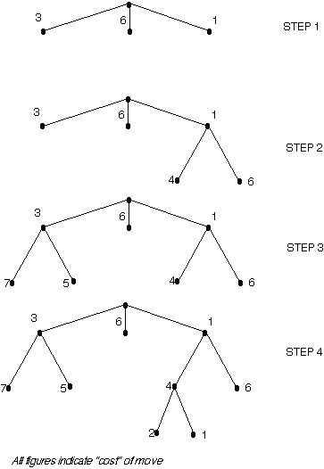

Slide 11
A* search
Best-known form of best-first search.
Idea: avoid expanding paths that are already expensive.
Evaluation function f(n)=g(n) + h(n)
  g(n) the cost (so far) to reach the node.
  h(n) estimated cost to get from the node to the goal.
  f(n) estimated total cost of path through n to goal.

Slide 12
A* ALGORITHM
Best First Search is a simplification of A* Algorithm
Algorithm uses:
  f’: Heuristic function that estimates the merits of each node we generate. This is sum of two components, g and h’
    f’ represents an estimate of the cost of getting from the initial state to a goal state along with the path that generated the current node.
  g : The function g is a measure of the cost of getting from initial state to the current node.
  h’ : The function h’ is an estimate of the additional cost of getting from the current node to a goal state.
  OPEN
  CLOSED

Slide 13
ALGORITHM A*
Algorithm A* (Hart et al., 1968):
f(n) = g(n) + h(n)
h(n) = cost of the cheapest path from node n to a goal state.
g(n) = cost of the cheapest path from the initial state to node n.
Algorithm A*:
f*(n) = g*(n) + h*(n)
h*(n) (heuristic factor) = estimate of h(n).
g*(n) (depth factor) = approximation of g(n) found by A* so far.

Slide 14
A* search
A* search uses an admissible heuristic
  A heuristic is admissible if it never overestimates the cost to reach the goal
  Are optimistic
    Formally:
    1. h(n) <= h*(n) where h*(n) is the true cost from n
    2. h(n) >= 0 so h(G)>= 0 for any goal G.
    e.g. h_{SLD}(n) never overestimates the actual road distance

Slide 15
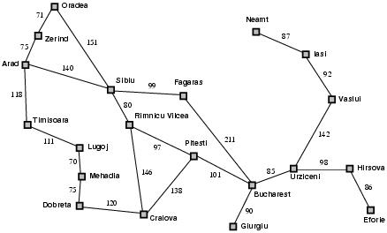
Romania example

Slide 16
A* search example
Find Bucharest starting at Arad
  f(Arad) = c(??,Arad)+h(Arad)=0+366=366

Slide 17

A* search example
Expand Arrad and determine f(n) for each node
  f(Sibiu)=c(Arad,Sibiu)+h(Sibiu)=140+253=393
  f(Timisoara)=c(Arad,Timisoara)+h(Timisoara)=118+329=447
  f(Zerind)=c(Arad,Zerind)+h(Zerind)=75+374=449
Best choice is Sibiu

Slide 18
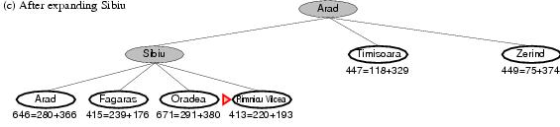
A* search example
Expand Sibiu and determine f(n) for each node
  f(Arad)=c(Sibiu,Arad)+h(Arad)=280+366=646
  f(Fagaras)=c(Sibiu,Fagaras)+h(Fagaras)=239+179=415
  f(Oradea)=c(Sibiu,Oradea)+h(Oradea)=291+380=671
  f(Rimnicu Vilcea)=c(Sibiu,Rimnicu Vilcea)+
  h(Rimnicu Vilcea)=220+192=413
Best choice is Rimnicu Vilcea

Slide 19
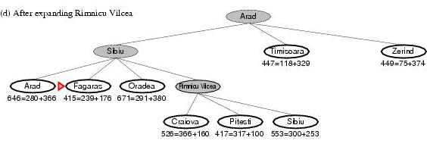
A* search example
Expand Rimnicu Vilcea and determine f(n) for each node
  f(Craiova)=c(Rimnicu Vilcea, Craiova)+h(Craiova)=360+160=526
  f(Pitesti)=c(Rimnicu Vilcea, Pitesti)+h(Pitesti)=317+100=417
  f(Sibiu)=c(Rimnicu Vilcea,Sibiu)+h(Sibiu)=300+253=553
Best choice is Fagaras

Slide 20
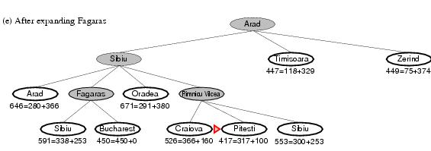
A* search example
Expand Fagaras and determine f(n) for each node
  f(Sibiu)=c(Fagaras, Sibiu)+h(Sibiu)=338+253=591
  f(Bucharest)=c(Fagaras,Bucharest)+h(Bucharest)=450+0=450
Best choice is Pitesti !!!

Slide 21
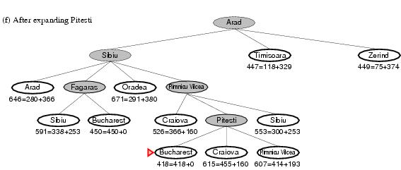
A* search example
Expand Pitesti and determine f(n) for each node
  f(Bucharest)=c(Pitesti,Bucharest)+h(Bucharest)=418+0=418
Best choice is Bucharest !!!
  Optimal solution (only if h(n) is admissable)
Note values along optimal path !!

Slide 22
A* ALGORITHM
Start with OPEN containing only initial node. Set that node’s g value to 0, its h’ value to whatever it is, and its f’ value to h’+0 or h’. Set CLOSED to empty list.
Until a goal node is found, repeat the following procedure:
  If there are no nodes on OPEN, report failure.
  Otherwise pick the node on OPEN with the lowest f’ value. Call it BESTNODE. Remove it from OPEN. Place it in CLOSED.
    See if the BESTNODE is a goal state. If so exit and report a solution.
    Otherwise, generate the successors of BESTNODE but do not set the BESTNODE to point to them yet.

Slide 23
A* ALGORITHM ( CONTD….)
For each of the SUCCESSOR, do the following:
  Set SUCCESSOR to point back to BESTNODE. These backwards links will make it possible to recover the path once a solution is found.
  Compute g(SUCCESSOR) = g(BESTNODE) + the cost of getting from BESTNODE to SUCCESSOR
  See if SUCCESSOR is the same as any node on OPEN. If so call the node OLD.
  If SUCCESSOR was not on OPEN, see if it is on CLOSED. If so, call the node on CLOSED OLD and add OLD to the list of BESTNODE’s successors.
  If SUCCESSOR was not already on either OPEN or CLOSED, then put it on OPEN and add it to the list of BESTNODE’s successors. Compute f’(SUCCESSOR) = g(SUCCESSOR) + h’(SUCCESSOR)

Slide 24
OBSERVATIONS ABOUT A*
Role of g function: This lets us choose which node to expand next on the basis of not only of how good the node itself looks, but also on the basis of how good the path to the node was.
h, the distance of a node to the goal. If h’ is a perfect estimator of h, then A* will converge immediately to the goal with no search.

Slide 25

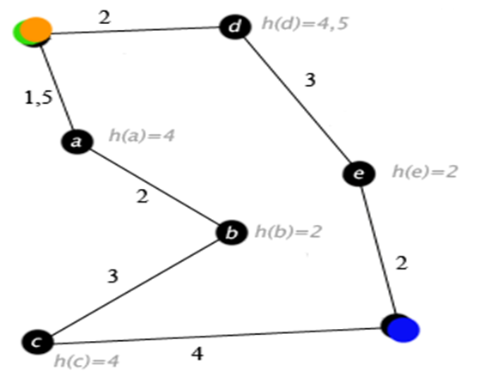

Slide 26
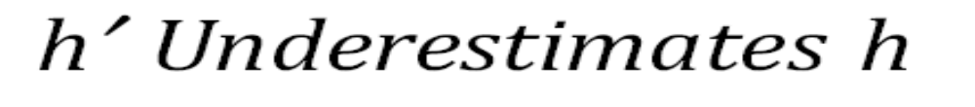
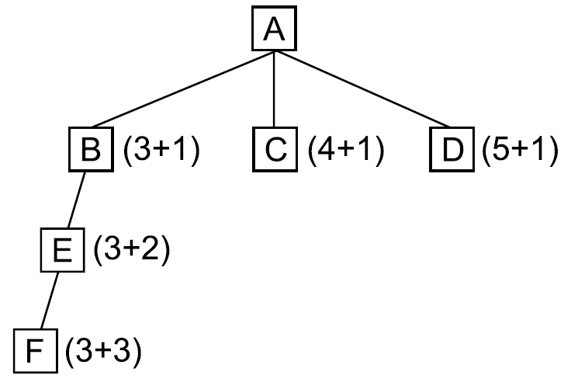
55

Slide 27

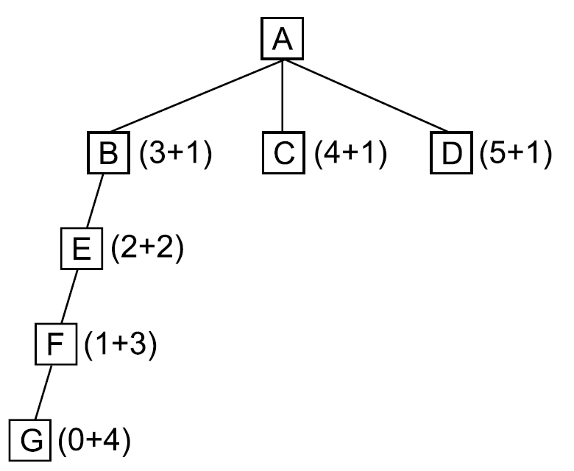
56

Slide 28
Algorithm : Agenda-Driven Search
Do until a goal state is reached or the agenda is empty:
Choose the most promising task from the agenda. Notice that this task can be represented in any desired form. It can be thought of as an explicit statement of what to do next or simply as an indication of the next node to be expanded.
(b) Execute the task by devoting to it the number of resources determined by its importance. The important resources to consider are time and space. Executing the task will probably generate additional tasks (successor nodes). For each of them, do the following:
See if it is already on the agenda. If so, then see if this same reason for doing it is already on its list of justifications. If so, ignore this current evidence. If this justification was not already present, add it to the list. If the task was not on the agenda, insert it.
(ii) Compute the new task’s rating, combining the evidence from all its justifications.
57

Slide 29


